Slide 1




ROADMAP
SUSTAINABLE AND ENERGY EFFICIENT BRICK PRODUCTION IN BANGLADESH 2019-2030
Prepared by Md. Nazmul Alam and Shaymal Barman

Slide 2
OUTLINE
CURRENT STATUS OF THE BRICK SECTOR
OPPORTUNITIES FOR CLEANER PRODUCTION
BARRIERS TO ACTION
THE ROADMAP

Slide 3
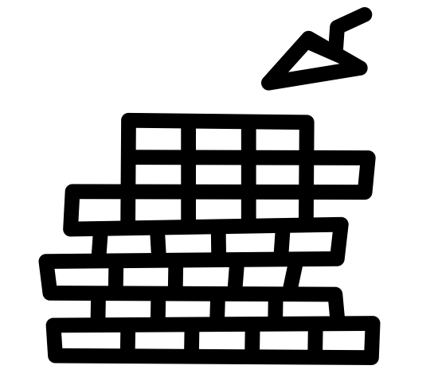
CURRENT STATUS OF THE BRICK SECTOR

Slide 4

Bricks are an indispensable resource for Bangladesh’s infrastructure development.
However, currently…
  Production methods are highly polluting, and this has proven difficult to regulate effectively
  Valuable clay topsoil from agricultural land is used as the primary raw material
  The sector is growing at 5-10% per year; by 2030 the country may produce 60 billion bricks per year (up from 34 billion today)

Slide 5
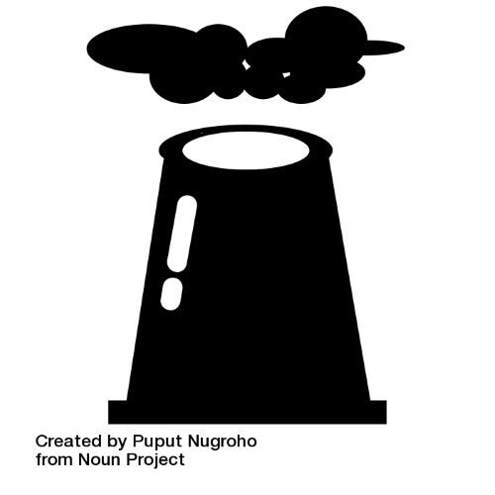
Brick sector snapshot
7,873 coal fired kilns
6 natural gas fired kilns
1.3% of GDP (BDT277.5 billion)
7 million tonnes of coal
21 million tonnes of CO₂
3.4 billion cubic feet of clay
1.6 million workers
58% of country’s PM2.5 (i.e., air pollution)

Slide 6

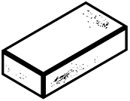

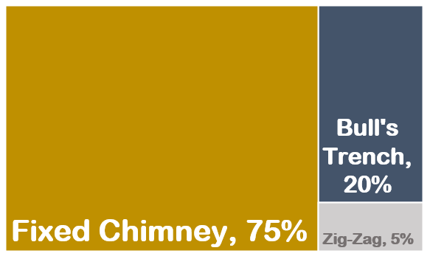
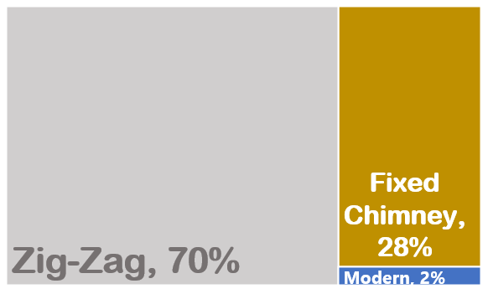
Market share of different traditional technologies
Government of Bangladesh environmental policies and lending schemes, together with donor-funded projects, have shifted brick production toward less polluting types of kilns:
2006
2018

Slide 7
Major factors influencing change since 2006
Directives from the Department of Environment
Brick Manufacturing and Kiln Establishment (Control) Act 2013
World Bank Clean Development Mechanism project
UNDP Green Brick project
World Bank Clean Air and Sustainable Environment project
ADB’s Financing Brick Kiln Efficiency Improvement project (loan/s)
ADB’s Supporting Brick Sector Development Program (technical assistance)

Slide 8
Energy and Emission Trends, 2006-2018
CO₂ emissions more than doubled during this time, from 8.7 to 21 million tonnes

Slide 9
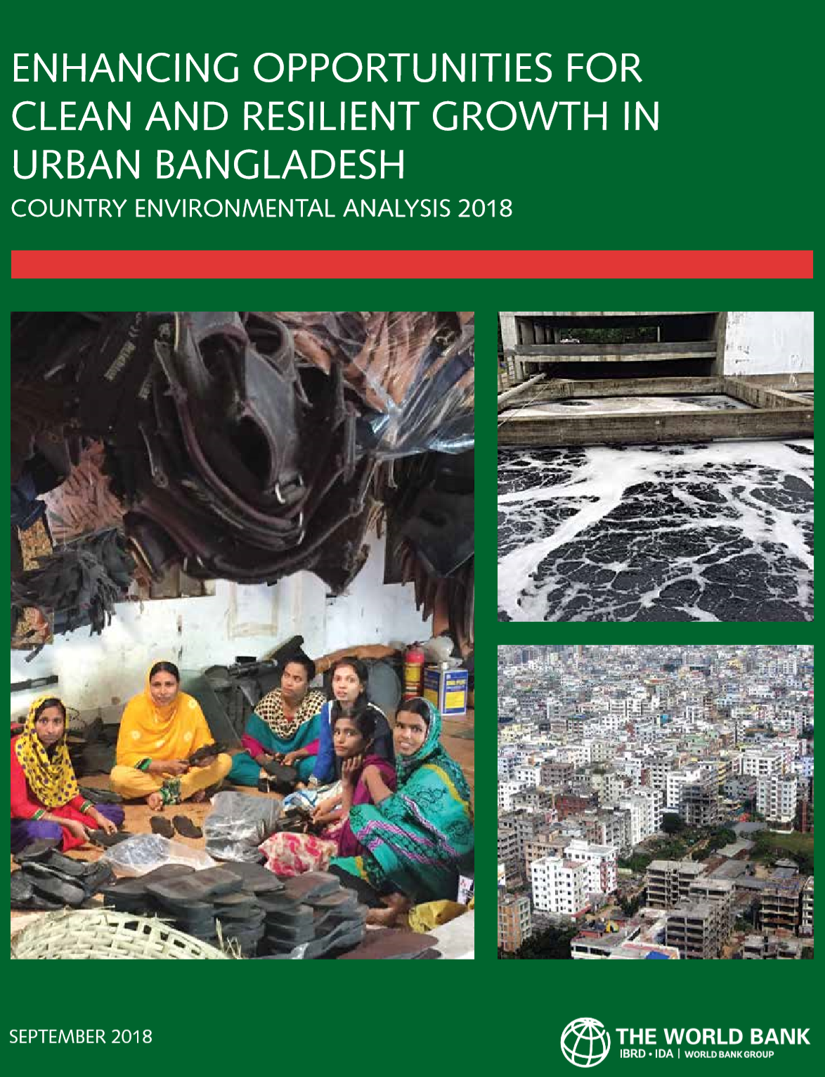
Air pollution is still a major problem
“Based on data from 11 continuous air quality monitoring stations in eight urban areas, the urban population-weighted annual PM2.5 concentration is estimated at 80ug/m³ for 2013-2015, more than five times the Bangladeshi standard and eight times the World Health Organization guideline. The source apportionment undertaken by the Department of Environment identifies vehicles and brick kilns among the key sources.” From →

Slide 10
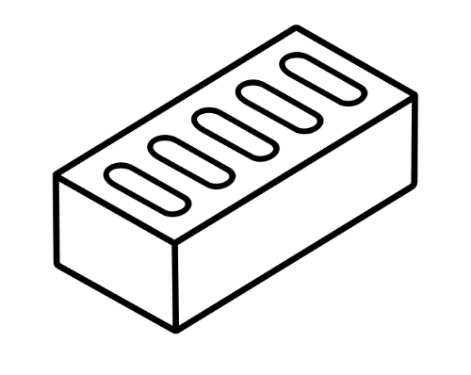
OPPORTUNITIES FOR CLEANER PRODUCTION

Slide 11
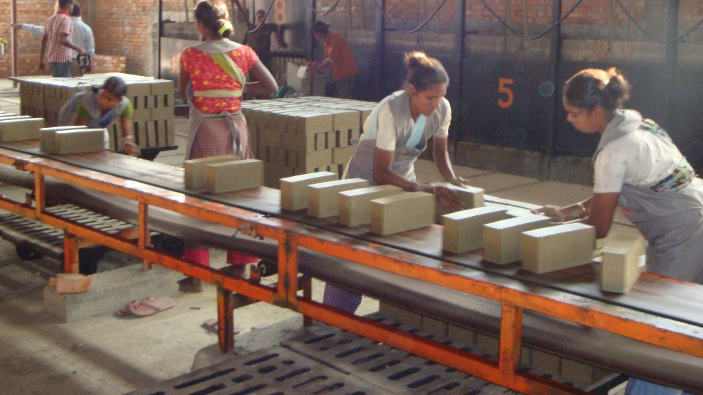
Hybrid Hoffman and Tunnel Kilns
Reduced coal usage by 40-50%
More efficient firing processes (but this requires skillful design, management and labor)
Can produce hollow/perforated bricks, which require less energy and have good insulation properties
Instead of topsoil, less valuable types of soil are preferable (i.e., riverbed soil, riverbank soil, soil from barren/fallow land)
Occupy less land and have greater production capacity
Operate year round instead of seasonally
Better wages and labor standards
At least $4.2 million USD upfront investment required for a single kiln

Slide 12
Non-fired bricks
The most sustainable and energy efficient option
Do not require coal
Use sand, cement, stones, pebbles and gravel as raw material
Leadership for local design options through Housing and Building Research Institute and others (BUET, JICA etc.)
Limitations:
→ limited availability of stone
→ lack of standards for strength/durability etc.
→ market demand and public awareness are low

Slide 13
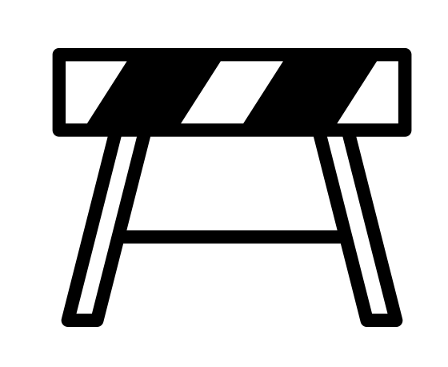
BARRIERS TO ACTION

Slide 14
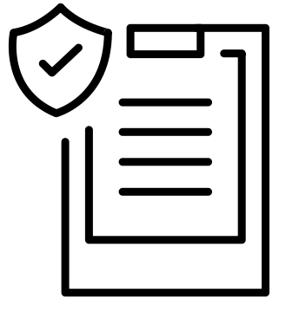
Policy/Regulatory Barriers
Energy efficient kiln enterprises operate under the same (cumbersome) regulatory and licensing requirements as traditional kilns, yet are very different kinds of enterprises (i.e., they are larger scale, use modern/heavy infrastructure and are less polluting)
Incongruence in the Brick Manufacturing and Kiln Establishment (Control) Act 2013 between certain clauses and ground reality related to clay sourcing, raw material and fuel transport, and coal quality monitoring
No regulatory policy or standards for non-fired bricks

Slide 15

Finance/Investment Barriers
High interest rates
Inadequate knowledge of technical aspects of modern kilns among loan intermediaries makes technical and financial appraisals of new brick projects challenging
Bangladesh Bank’s Green Fund program has a cap of BDT 100 million for a single borrower; this prevents the program from funding modern kilns because the required debt financing for these kilns is higher
No significant investments in growth of market demand for or production of non-fired bricks

Slide 16
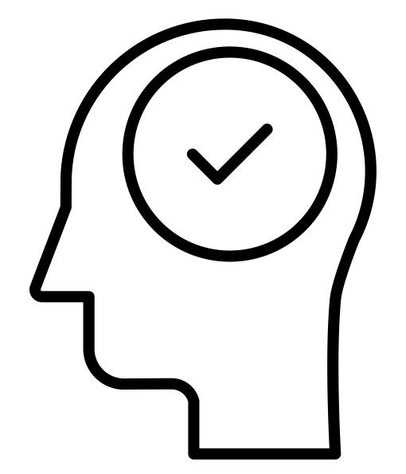
Knowledge/Capacity Barriers
Inadequate knowledge of appropriate design specifications and production optimization for modern/energy efficient kilns
  This has resulted in reduced kiln productivity and efficiency, and
  unsatisfactory revenue and loan repayment
  →As a result, banks, non-bank financial institutions and financial intermediaries
  are discouraged from issuing loans for these projects
Limited awareness among builders of importance of and options for purchasing non-fired bricks for construction projects

Slide 17
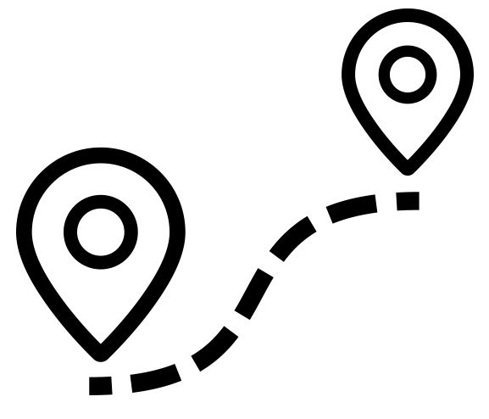
THE ROADMAP

Slide 18
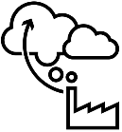


ROADMAP GOALS
Reduce carbon dioxide (CO2) production by 45%
and air pollution (PM2.5) by 90%
Minimize coal burning
Use renewable raw materials (e.g., sand, river dredge,
fly ash, stones, gravel etc.) instead of clay topsoil

Slide 19


ROAPMAP SNAPSHOT
GOALS
I Reduce carbon dioxide (CO₂) and air pollution (PM2.5)
I Minimize coal burning
I Use renewable raw materials instead of agricultural topsoil
IMMEDIATE ACTIONS:
$3.9M USD for implementation of the Roadmap’s essential elements
Shut down all Fixed Chimney Kilns by the end of 2020, and 80% of Zig-Zag kilns by 2025
Provide a new line of credit for entrepreneurs who intend to establish new Tunnel kilns
Build investment projects for R&D, raw material mapping and market demand generation for
non-fired bricks
Begin training programs to build technical expertise among brick sector workers (from laborers to senior design technicians) and lenders
$860M USD in credit for new, modern brick making establishments
(fired and non-fired)
45% reduction in CO₂ from “Business as Usual” levels
90% reduction in PM2.5 generated from brick production

Slide 20
TECHNOLOGY TRANSITION TIMELINE
2019
2025
2030
Highly polluting kilns Energy efficient kilns Non-fired bricks
Fixed chimney Hybrid Hoffman Compressed concrete blocks
Zig-Zag Tunnel Aerated autoclaved concrete blocks

Slide 21
Strategic Objective 1: Strengthen the Policy Environment
Declare brick production an INDUSTRY to streamline licensing and oversight Collect geocodes for all brick kilns to better track and enforce licensing requirements Amend the Brick Manufacturing and Establishment Act 2013 to 1) clarify rules for raw material sourcing and transport, 2) adjust guidelines for coal quality monitoring, and 3) institute incentives for clean technology Update National Building Code to encourage use of sustainable, non-polluting building materials Extend regulations across the value chain to incentivize environmentally friendly production

Slide 22
Strategic Objective 2: Enhance Energy and Resource Efficiency
By 2030, phase out traditional brick kilns that burn coal inefficiently and rely on clay topsoil Develop standards for non-fired brick products to facilitate their market entry and growth Conduct a national mapping of raw materials for fired and non-fired bricks Promote and incentivize more environmentally friendly hollow bricks Invest in research and development on new raw materials that can replace clay

Slide 23
Strategic Objective 3: Facilitate Access to Finance and Incentives
Invest in financing the development of a range of non-fired brick technologies Establish credit channels (for +/-$350 million USD) to fund the establishment of new, energy efficient auto brick kilns, thus increasing their market share Provide seed funding to traditional brick kiln owners for livelihood alternatives Create financial incentives (e.g., preferential tax and/or interest rate options) for clean production

Slide 24
Strategic Objective 4: Capacity and Institutional Framework
Launch a national brickmaking training center Increase public awareness of energy efficient and non-fired bricks, including technology and production options Establish a raw material testing laboratory to ensure the availability of appropriate, investment grade materials for the sector

